Slide 1
Applied Deep Learning
Group 10
Xiao, Chuqiao
Wang, Ruiqi
Ren, Yingying
Peng, Junming
Sulaiman, Muhammad

Slide 2
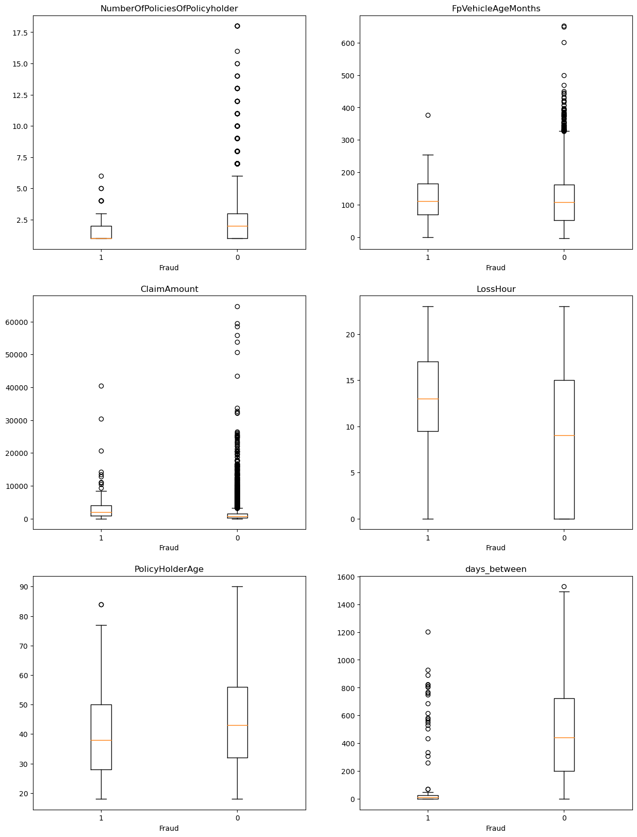
Overview
Objectives
Feature analysis
Loss functions:
(1 – Hit rate) * (Detection rate * Total claims) * Cost1
[Frauds – hit rate * (Detection rate * Total claims)] * Cost2
Descriptions:
Hit rate: Real fraud/Suspicious fraud detected
Detection rate: Suspicious fraud detected/Total claims
Total claims: All claims which includes real frauds and non-frauds
Frauds: Number of claims which is fraud
Cost1: Cost of investigation per claim
Cost2: Cost for average claim of frauds for each claim
Firstly, delete the unexplainable columns and we get the 121 features.
Next, use boxplots (as shown in the figure) to compare the distribution of numerical features between fraudulent and non-fraudulent observations.
Then, combine them with the importance scores from the decision tree model excluding the least important features to get a dataset with 31 features.

Slide 3
Model
Simple model
Decision Tree
Neural Network
Autoencoder
At t = 51.623, both detection rate and hit rate is 0.0888.
Highest transparency as calculations are based on a single feature.
This model can’t be used to compare with other models as the parameters being used are not the same.
The hit rate is 0.095 and the detection rate is 0.012.
This model is the second-best model. Although the detection rate is lower than the simple model, the hit rate is the better.
The transparency is second-highest as they can classify the claims based on parameters based on a tree plot.
The hit rate is 0.154 and the detection rate is 0.015.
This model is the best as the detection rate is the highest.
The transparency is lowest as it is a complex model with many convolutional layers and parameters making it less interpretable.
The hit rate is 0.017 and the detection rate is 0.840.
This model is the worse as the hit rate is the lowest and the detection rate is too high which is unexplainable and would cost a fortune.
The transparency is comparable to the Neural Network as they require more computational resources and training time.

Slide 4
Conclusion
Challenges
Suggestions
Data preparation including cleaning, pre-processing, and feature engineering is a time-consuming process and a challenging process.
This is because the machine learning model heavily relies on the quality of the data used to train it.
Neural networks are very complex and can be difficult to determine the appropriate architecture for a given problem.
Use the approach of oversampling to handle an imbalanced dataset, where we duplicate samples from the minority class to make the number of samples equal to the majority class. This will help to improve our machine learning model.
However, oversampling can also lead to overfitting if not done carefully, so it’s important to evaluate the performance of the model on a separate validation set.

